Slide 1
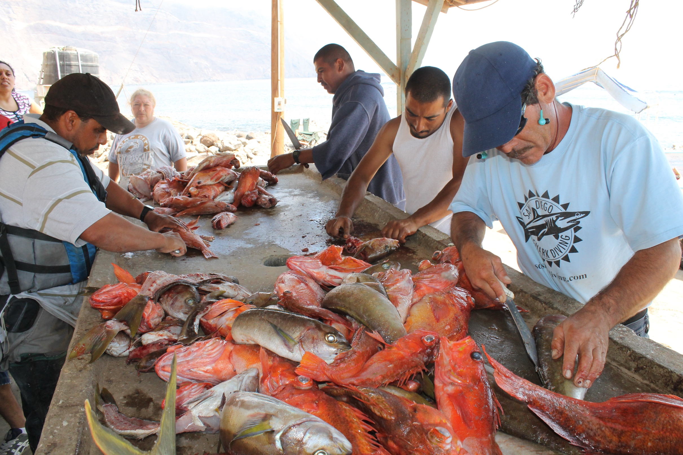
Framework to evaluate marine reserves in Mexico
Caio Faro, Jael Martinez, Juan Carlos Villasenor, Melaina Wright

Slide 2






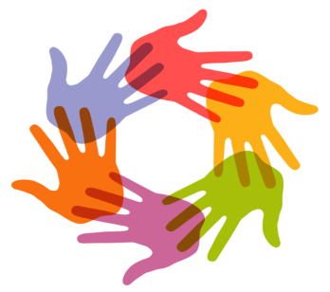
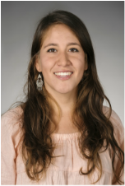
Introduction
Notes:
-4 of us, each have a role (ex. project manager) and each will divide work on the project, we are supported by Costello our faculty advisor and Sean our PhD advisor, and external advisors to provide us with additional support and expertise

Slide 3
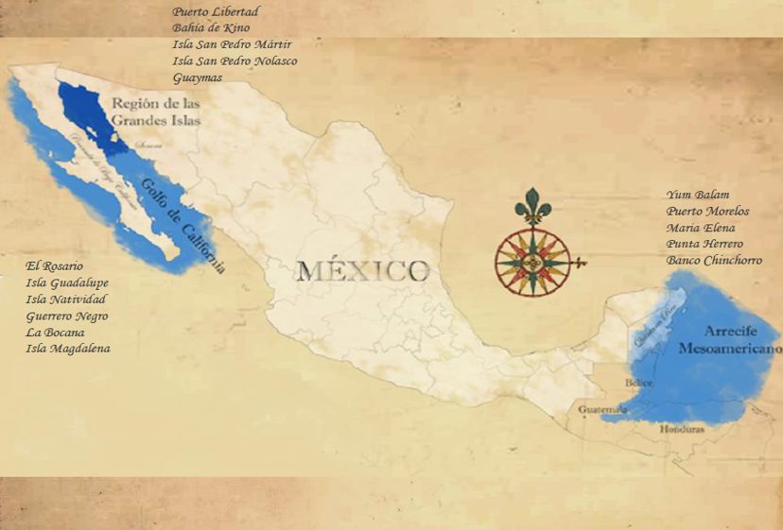
Background
Figure 1: Regionalization of COBI’s working areas (in blue) and the fishing communities with whom they collaborate (labels). Source: COBI
Notes:
-After more than 15 years of collaboration with fishermen, COBI has been involved in the creation of 29 community-based no-take marine reserves (21,106 hectares) distributed among 13 different communities in the Gulf of California, Pacific coast of Baja Peninsula, and the Caribbean. They also collaborate with government agencies to design and monitor 10 Marine Protected Areas (617,703 hectares) that have no-take marine reserves (58,348 hectares) within their perimeters (i.e. core zones).
-These marine reserves can be no-take (fishing is off-limits), partially protected (extraction of specific species is not allowed), temporarily protected (only for a period of time) or a combination of temporal and partial protections.

Slide 4
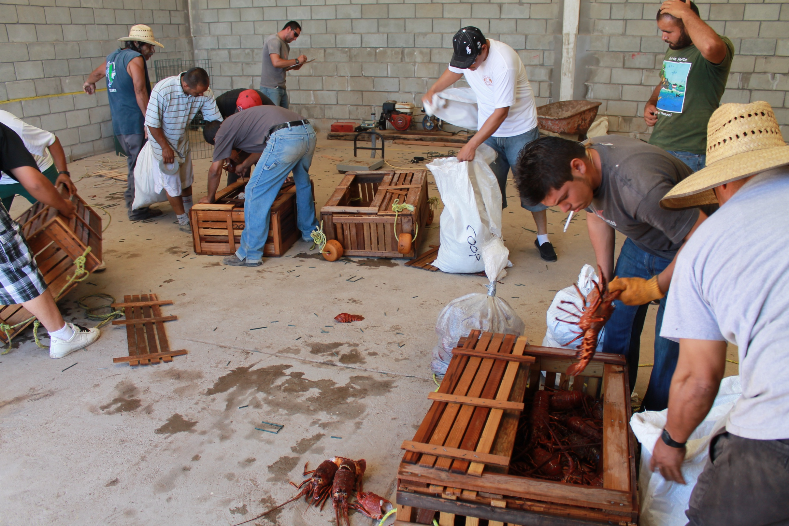
Have reserves met their objectives?
Notes:
-The extent to which these reserves have met their objectives is unclear. Each community has unique culture, natural resources, vulnerabilities, and governance structures. This hinders the use of conventional frameworks that evaluate the effectiveness of no-take marine reserves, and calls for the development of an appropriate tool capable of measuring effectiveness under the current scenario.

Slide 5
1. Determine a set of biophysical, socioeconomic and governance indicators that can be used to evaluate the effectiveness of no-take marine reserves in Mexico. 2. Use the selected indicators to propose a framework for evaluating the effectiveness of no-take marine reserves in Mexico. 3. Develop an English/Spanish guidebook with the selected indicators that walks the user through implementing our framework.
Objectives
Notes:
-The extent to which these reserves have met their objectives is unclear. Each community has unique culture, natural resources, vulnerabilities, and governance structures. This hinders the use of conventional frameworks that evaluate the effectiveness of no-take marine reserves, and calls for the development of an appropriate tool capable of measuring effectiveness under the current scenario.

Slide 6
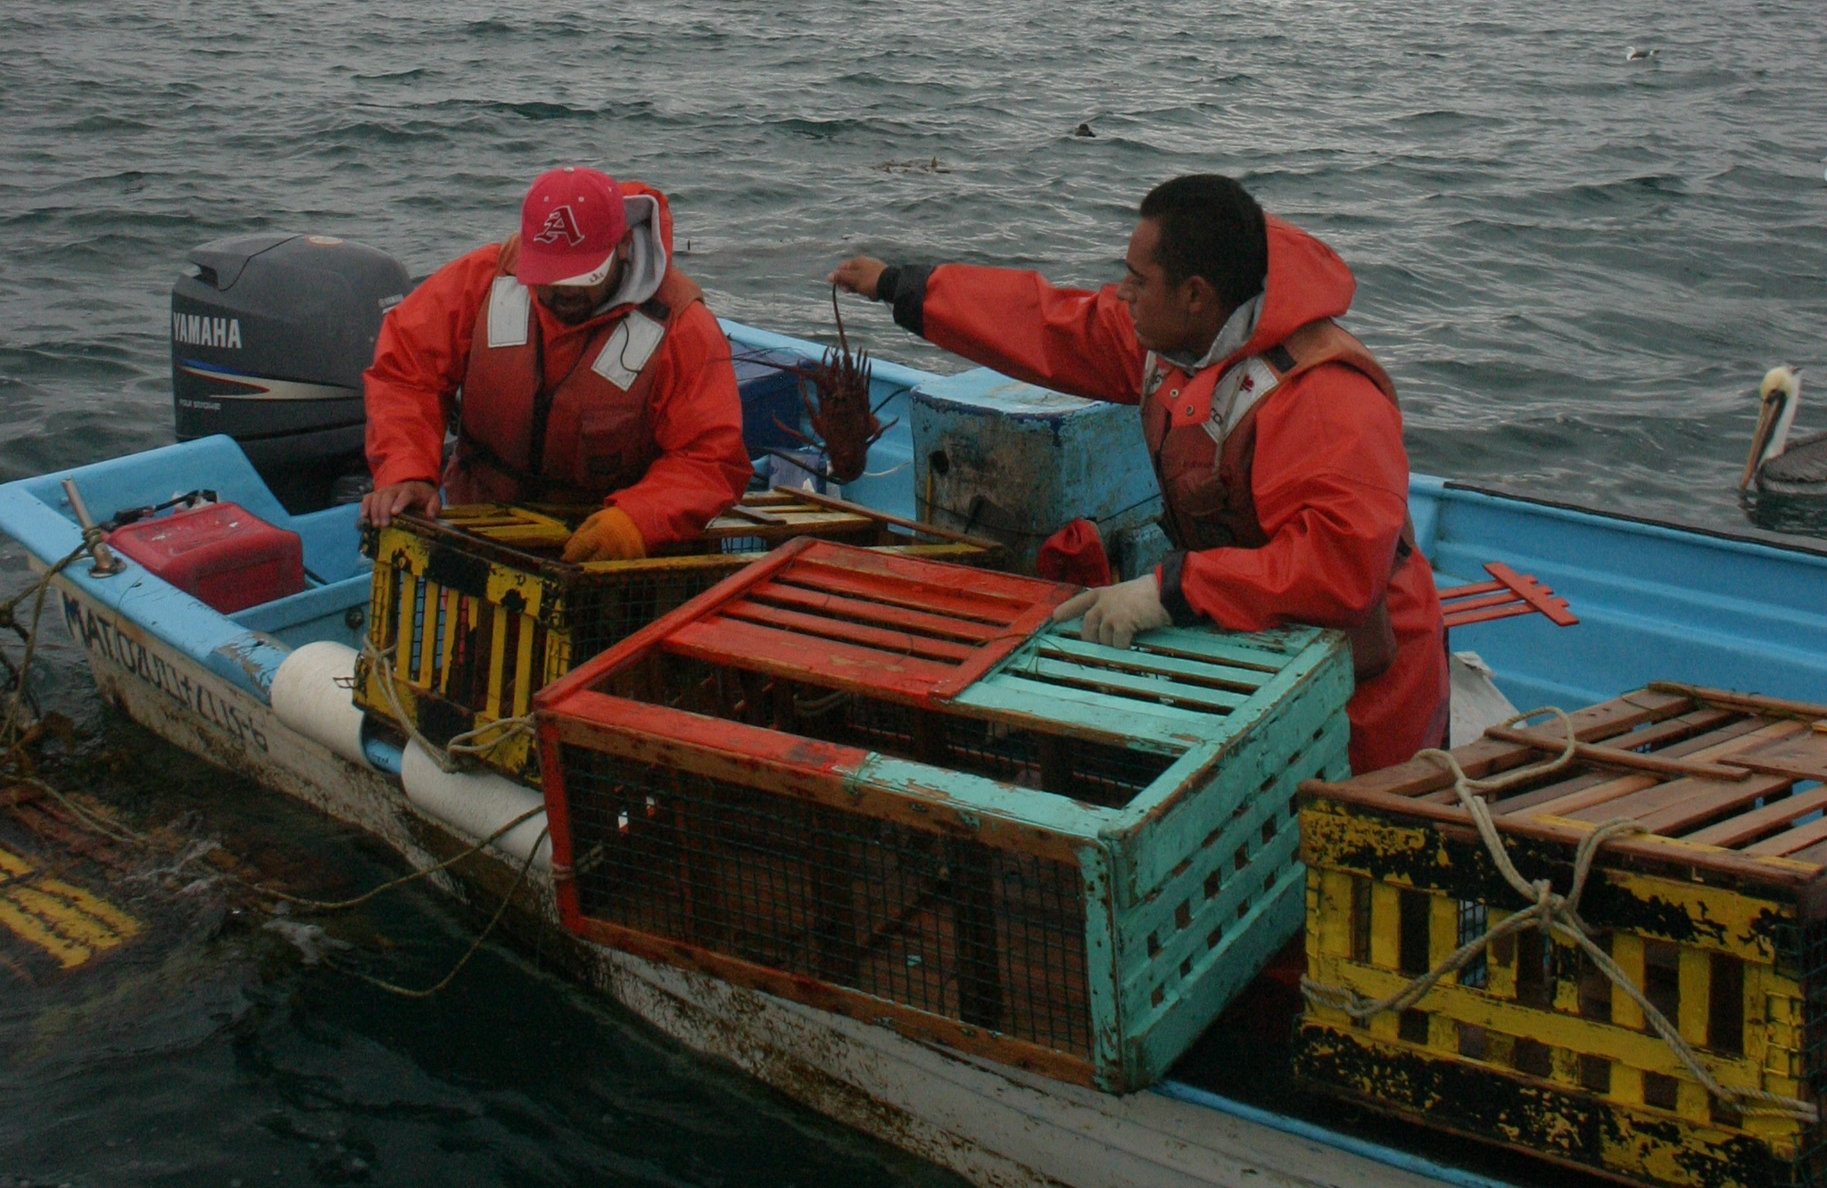
Analysis approach
Input:
Reserve and control
Post and pre-implementation
Analysis:
Difference-in-difference
Output:
DD estimate
P-value
Notes:
-Biophysical or landings (total or specific spp): Input of what you need ex. fish abundance and get post-pre treatment and control, DID by hand vs. linear regression, output: value of the DD estimate (positive or negative) trend and if do it by regression if this trend is significant
-We are still working on how we are going to analyze the governance indicators (since are explanatory)

Slide 7
Guidebook Sections
Introduction
Selection of indicators
Data Collection
Data Formatting
Analysis
Interpretation of results
Recommendations for improvement
Notes:
-Sections of guidebook: Introduction, Selection of Indicators (depend on objectives of reserve), Data collection, Data Formatting, Analysis: subsection for biophysical, governance and social; Interpretation of results: for each type of indicator; Recommendations for improvement

Slide 8
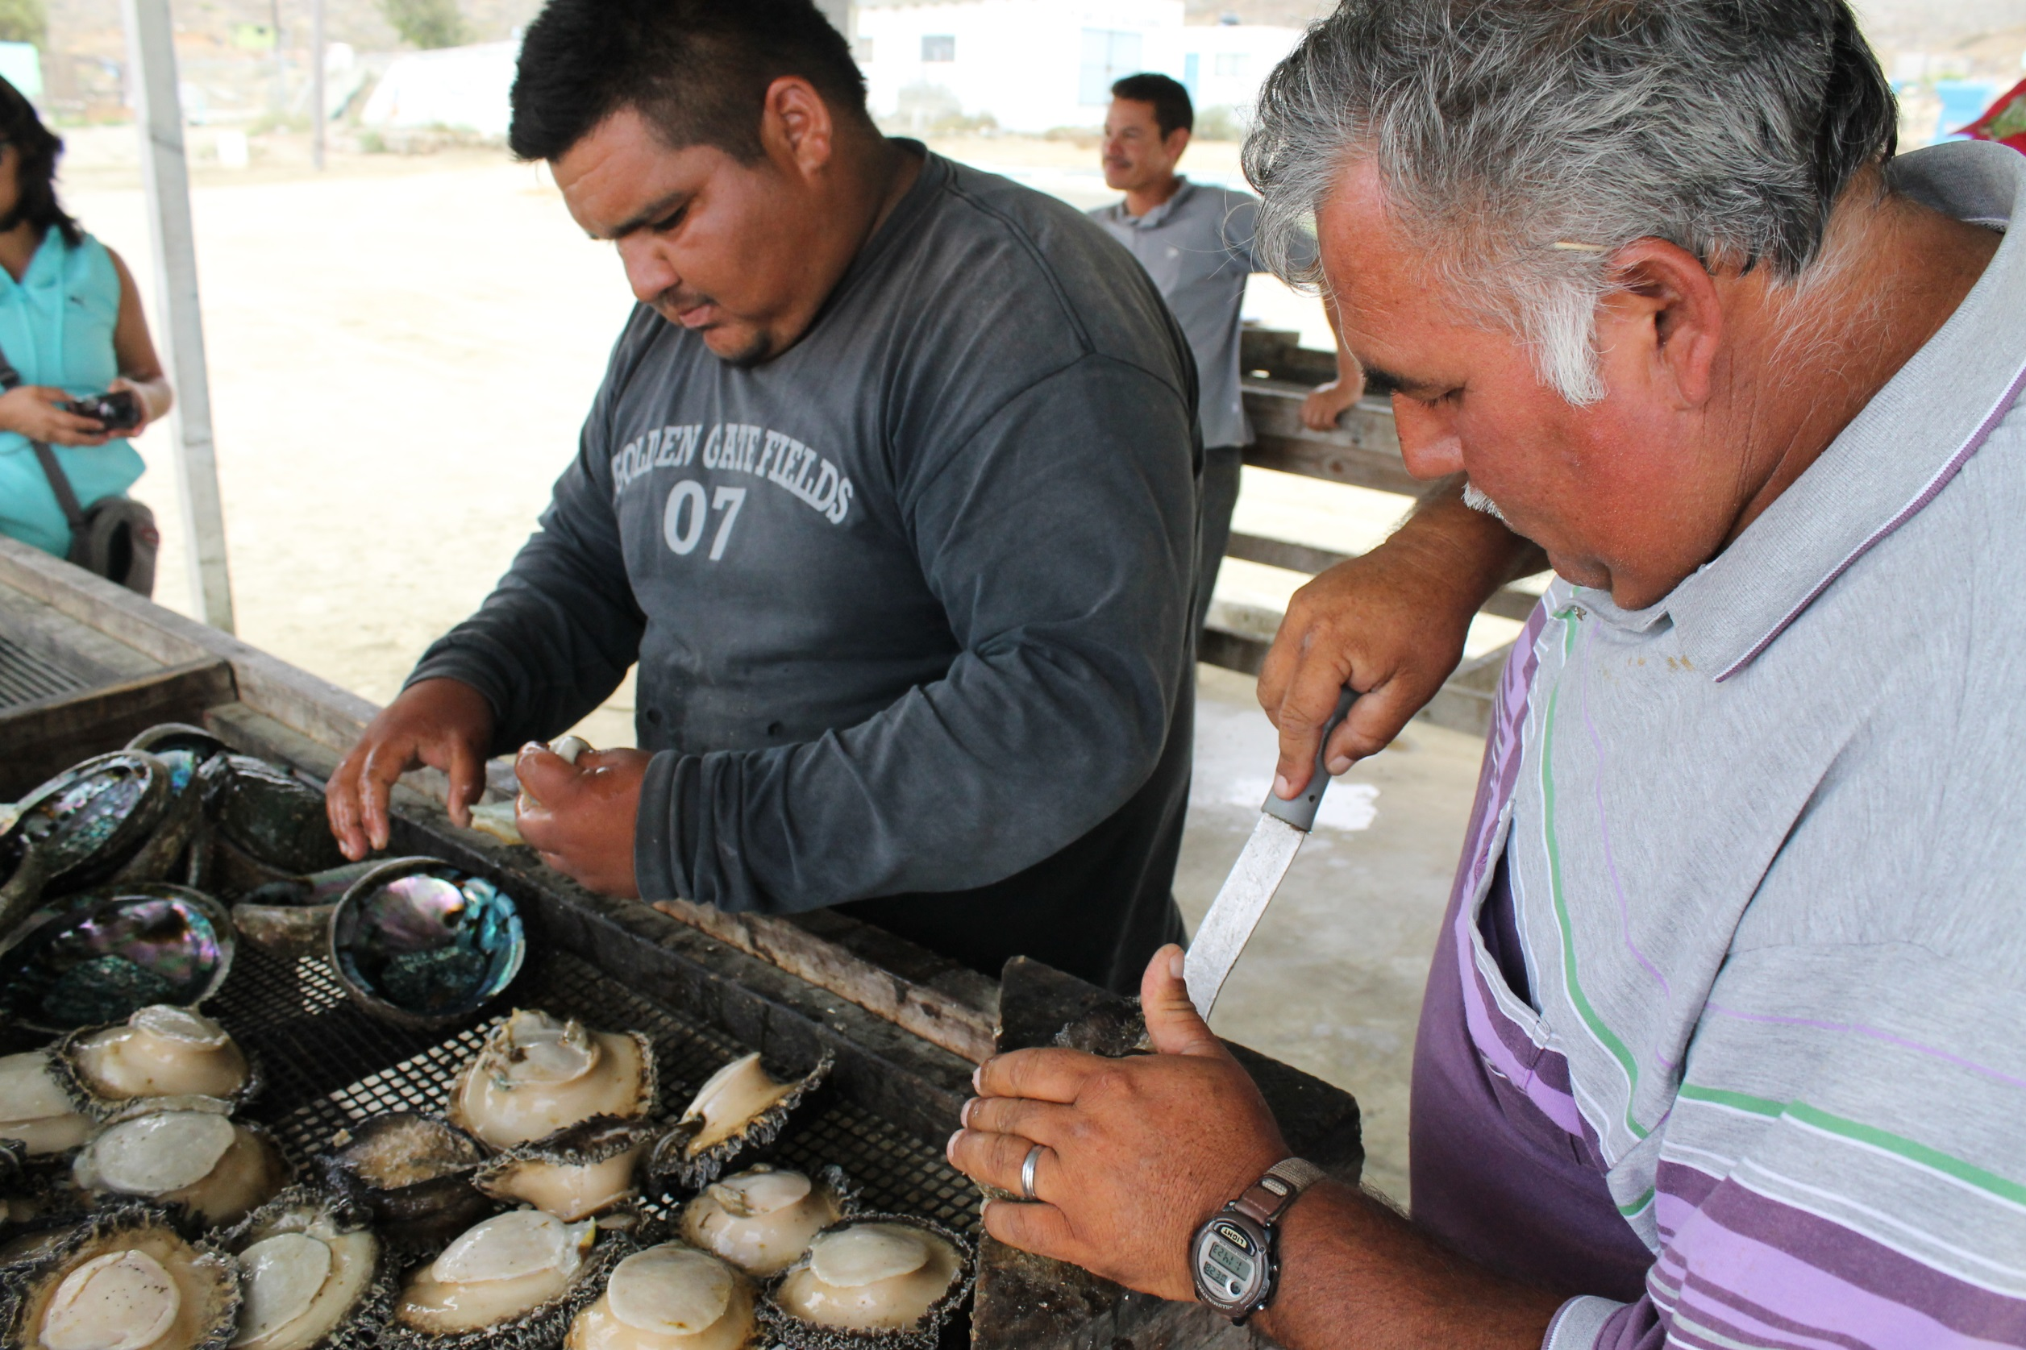
Shiny app Interface

Slide 9
No-take reserve effectiveness calculator
Choose the objectives of your NTZ
Choose your no-take reserve
Protect/restore the ecosystem
Improve nearby fisheries
Protect specific species
Continue

Slide 10
No-take reserve effectiveness calculator
For the objectives you chose, your file should look like this table:
Location | Site | Year | Species | Abundance
El Rosario | Punta Patos | 2014 | P. clathratus | 1
El Rosario | Punta Patos | 2013 | P. clathratus | 2
El Rosario | La Caracolera | 2014 | P. clathratus | 5
El Rosario | La Caracolera | 2013 | P. clathratus | 2
Select your file
Continue
Upload

Slide 11
No-take reserve effectiveness calculator
Your reserve is achieving its objectives!
Click on the button below to download a detailed report.
Report

Slide 12
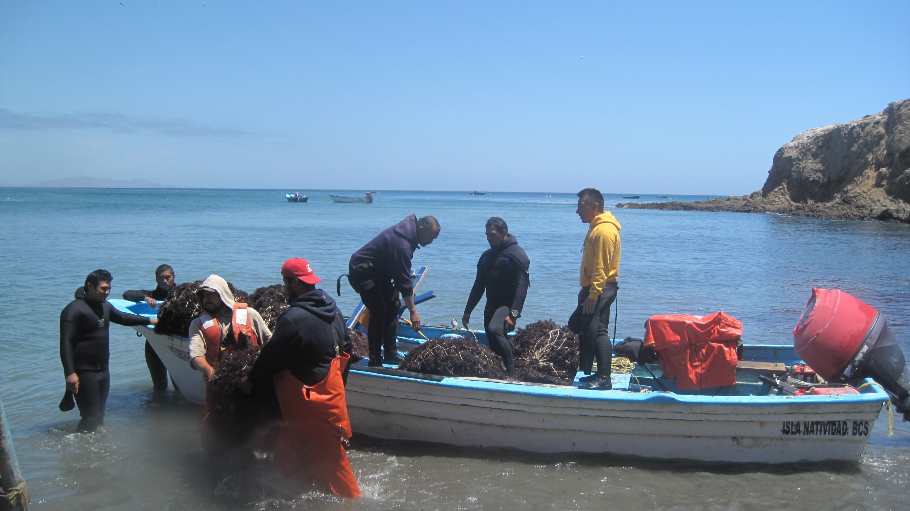
Next steps
Literature review
Data formatting
Survey
Run analyses together

Slide 13
Questions?

